Slide 1
Question:
From the following link extract the weather data: https://github.com/tomwhite/hadoop-book/tree/master/input/ncdc/all
Create a Map Reduce program to: a) Find average temperature for each year from
NCDC data set. b) Find the mean max temperature for every month.

Slide 2
Dataset Description
If we consider the details mentioned in the ﬁle, each ﬁle has entries that look like this: 0029029070999991905010106004+64333+023450FM
2+000599999V0202301N008219999999N0000001N9-01391+99999102641ADDGF102991999999999999999
999
When we consider the highlighted ﬁelds, the ﬁrst one (029070) is the USAF weather station identiﬁer. The next one (19050101) represents the observation date.
The third highlighted one (0139)represents the air temperature in Celsius times ten. So the reading of 0139 equates to 13.9 degrees Celsius.
The next highlighted and italic item indicates a reading quality code.

Slide 3
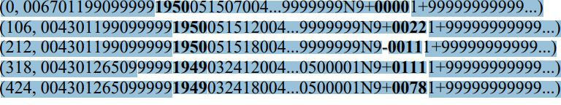
The input to our map phase is the raw NCDC data. To visualize the way the map works, consider the following sample lines of input data (some unused columns have been dropped to fit the page, indicated by ellipses):
0067011990999991950051507004...9999999N9+00001+99999999999...
0043011990999991950051512004...9999999N9+00221+99999999999...
0043011990999991950051518004...9999999N9-00111+99999999999...
0043012650999991949032412004...0500001N9+01111+99999999999...
0043012650999991949032418004...0500001N9+00781+99999999999...
These lines are presented to the map function as the key-value pairs:

Slide 4
The map function merely extracts the year and the air temperature
(indicated in bold text), and emits them as its output (the temperature values have been interpreted as integers):
(1950, 0)
(1950, 22)
(1950, −11)
(1949, 111)
(1949, 78)
our reduce function sees the following input:
(1949, [111, 78])
(1950, [0, 22, −11])
All the reduce function has to do now is iterate through the list and pick up the maximum reading:
(1949, 111)
(1950, 22)

Slide 5
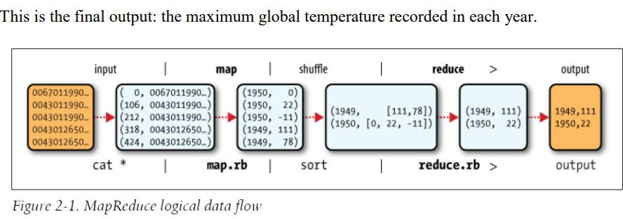

Slide 6
a) Find average temperature for each year from NCDC data set.
AverageDriver:
package temp;
import org.apache.hadoop.fs.Path;
import org.apache.hadoop.io.IntWritable;
import org.apache.hadoop.io.Text;
import org.apache.hadoop.mapreduce.Job;
import org.apache.hadoop.mapreduce.lib.input.FileInputFormat;
import org.apache.hadoop.mapreduce.lib.output.FileOutputFormat;
public class AverageDriver {
public static void main(String[] args) throws Exception {
if (args.length != 2) {
System.err.println("Please Enter the input and output parameters");
System.exit(-1);
}
Job job = new Job();
job.setJarByClass(AverageDriver.class);
job.setJobName("Max temperature");
FileInputFormat.addInputPath(job, new Path(args[0]));
FileOutputFormat.setOutputPath(job, new Path(args[1]));
job.setMapperClass(AverageMapper.class);
job.setReducerClass(AverageReducer.class);
job.setOutputKeyClass(Text.class);
job.setOutputValueClass(IntWritable.class);
System.exit(job.waitForCompletion(true) ? 0 : 1);
}
}

Slide 7
AverageMapper:
package temp;
import java.io.IOException;
import org.apache.hadoop.io.IntWritable;
import org.apache.hadoop.io.LongWritable;
import org.apache.hadoop.io.Text;
import org.apache.hadoop.mapreduce.Mapper;
public class AverageMapper extends Mapper<LongWritable, Text, Text, IntWritable> {
public static final int MISSING = 9999;
public void map(LongWritable key, Text value, Mapper<LongWritable, Text, Text,
IntWritable>.Context context) throws IOException, InterruptedException {
int temperature;
String line = value.toString();
String year = line.substring(15, 19);
if (line.charAt(87) == '+') {
temperature = Integer.parseInt(line.substring(88, 92));
} else {
temperature = Integer.parseInt(line.substring(87, 92));
}
String quality = line.substring(92, 93);
if (temperature != 9999 && quality.matches("[01459]"))
context.write(new Text(year), new IntWritable(temperature));
}
}

Slide 8
AverageReducer:
package temp;
import java.io.IOException;
import org.apache.hadoop.io.IntWritable;
import org.apache.hadoop.io.Text;
import org.apache.hadoop.mapreduce.Reducer;
public class AverageReducer extends Reducer<Text, IntWritable, Text, IntWritable> {
public void reduce(Text key, Iterable<IntWritable> values, Reducer<Text, IntWritable,
Text, IntWritable>.Context context) throws IOException, InterruptedException {
int max_temp = 0;
int count = 0;
for (IntWritable value : values) {
max_temp += value.get();
count++;
}
context.write(key, new IntWritable(max_temp / count));
}}

Slide 9
b) find the mean max temperature for every month
MeanMaxDriver.class
package meanmax;
import org.apache.hadoop.fs.Path;
import org.apache.hadoop.io.IntWritable;
import org.apache.hadoop.io.Text;
import org.apache.hadoop.mapreduce.Job;
import org.apache.hadoop.mapreduce.lib.input.FileInputFormat;
import org.apache.hadoop.mapreduce.lib.output.FileOutputFormat;
public class MeanMaxDriver {
public static void main(String[] args) throws Exception {
if (args.length != 2) {
System.err.println("Please Enter the input and output parameters");
System.exit(-1);
}
Job job = new Job();
job.setJarByClass(MeanMaxDriver.class);
job.setJobName("Max temperature");
FileInputFormat.addInputPath(job, new Path(args[0]));
FileOutputFormat.setOutputPath(job, new Path(args[1]));
job.setMapperClass(MeanMaxMapper.class);
job.setReducerClass(MeanMaxReducer.class);
job.setOutputKeyClass(Text.class);
job.setOutputValueClass(IntWritable.class);
System.exit(job.waitForCompletion(true) ? 0 : 1);
}
}

Slide 10
MeanMaxMapper.class
package meanmax;
import java.io.IOException;
import org.apache.hadoop.io.IntWritable;
import org.apache.hadoop.io.LongWritable;
import org.apache.hadoop.io.Text;
import org.apache.hadoop.mapreduce.Mapper;
public class MeanMaxMapper extends Mapper<LongWritable, Text, Text, IntWritable> {
public static final int MISSING = 9999;
public void map(LongWritable key, Text value, Mapper<LongWritable, Text, Text,
IntWritable>.Context context) throws IOException, InterruptedException {
int temperature;
String line = value.toString();
String month = line.substring(19, 21);
if (line.charAt(87) == '+') {
temperature = Integer.parseInt(line.substring(88, 92));
} else {
temperature = Integer.parseInt(line.substring(87, 92));
}
String quality = line.substring(92, 93);
if (temperature != 9999 && quality.matches("[01459]"))
context.write(new Text(month), new IntWritable(temperature));
}
}

Slide 11
MeanMaxReducer.class
package meanmax;
import java.io.IOException;
import org.apache.hadoop.io.IntWritable;
import org.apache.hadoop.io.Text;
import org.apache.hadoop.mapreduce.Reducer;
public class MeanMaxReducer extends Reducer<Text, IntWritable, Text, IntWritable> {
public void reduce(Text key, Iterable<IntWritable> values, Reducer<Text, IntWritable,
Text, IntWritable>.Context context) throws IOException, InterruptedException {
int max_temp = 0;
int total_temp = 0;
int count = 0;
int days = 0;
for (IntWritable value : values) {
int temp = value.get();
if (temp > max_temp)
max_temp = temp;
count++;
if (count == 3) {
total_temp += max_temp;
max_temp = 0;
count = 0;
days++;
}
}
context.write(key, new IntWritable(total_temp / days));
}
}

Slide 12
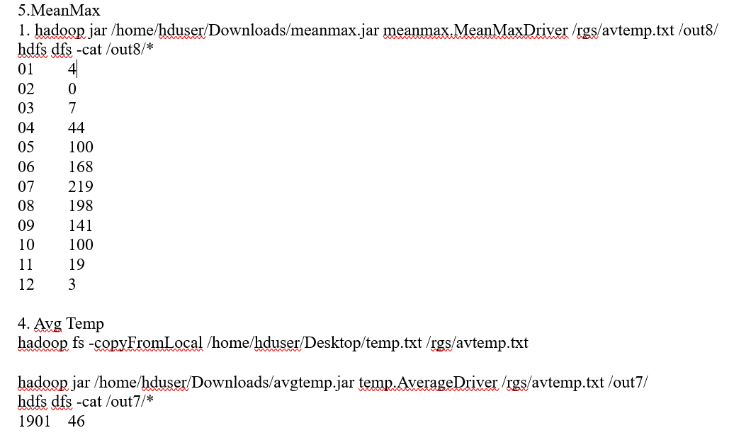

Slide 13
For a given Text file, Create a Map Reduce program to sort the content in an alphabetic order listing only top 10 maximum occurrences of words

Slide 14
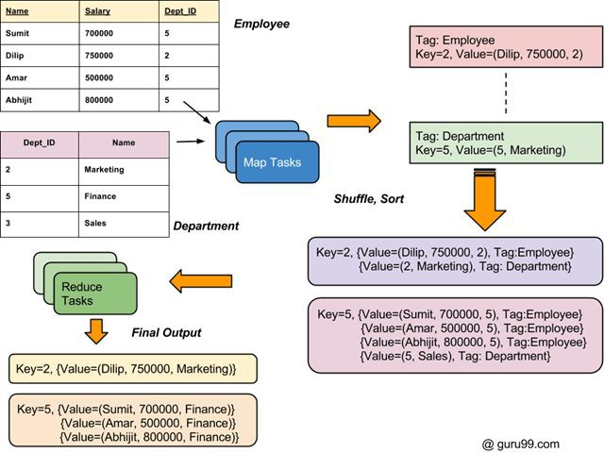

Slide 15
How to Join two DataSets: MapReduce Example
There are two Sets of Data in two Different Files (shown below). The Key Dept_ID is common in both files. The goal is to use MapReduce Join to combine these files

Slide 16
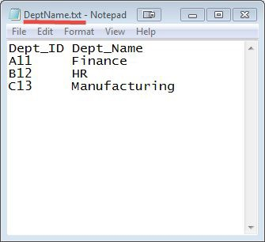
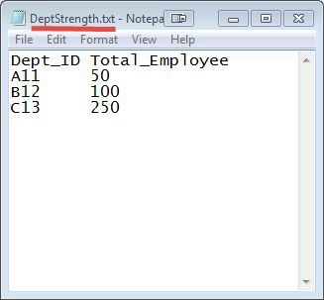

Slide 17

$HADOOP_HOME/bin/hdfs dfs -copyFromLocal DeptStrength.txt DeptName.txt /
$HADOOP_HOME/bin/hadoop jar MapReduceJoin.jar MapReduceJoin/JoinDriver/DeptStrength.txt /DeptName.txt /output_mapreducejoin
$HADOOP_HOME/bin/hdfs dfs -cat /output_mapreducejoin/part-00000

